Slide 1
Project CAR:
Companies Analysis of the Risk
SEMESTER 2020-1 (spring)
COURSE INC-CAPSTONEDESIGN-1
PROFESSOR CHUNG, HYUN-SOOK
LEADER LIM, HYEONG-YEOL
MEMBERS KIM, DONG-JIN
JO, JAE-HYEOK
KIM, TAE-WAN
DATE 2020. 6. 25. (Thu)

Slide 2
CONTENTS
1. CAR: Introduction of Team members
2. CAR: Purpose
2.1. CAR: Motivation
2.2. CAR: Purpose & Expectation
3. CAR : Process
3.1. CAR: Development Procedures & Environment
3.2. CAR: Project Flowchart
3.3. CAR: Project Design
3.4. CAR: Project Implementation
4. CAR: Result
5. References

Slide 3




1. CAR: Introduction of Team members
The team is made up of 4 people.
LIM, HYEONG-YEOL
JO, JAE-HYEOK
doodleima@naver.com
Data Processing
Data Analysis
jjhst2285@naver.com
Web Service Design
Web Service Implementation
KIM, DONG-JIN
KIM, TAE-WAN
engadoridori@gmail.com
Data Processing
Data Analysis
ktwan0782@gmail.com
DataBase Model Design
Web Service Design

Slide 4
2. CAR: Purpose
Do you know
What these cases have in common?
IMF Financial Crisis
(1997 ~ 2001)
World Financial Crisis
(from the US, 2007 ~ 2008)
COVID-19
(2019 ~ 2020(Current))
“Unpredictable”
“Liquidity Crisis Results”

Slide 5
2. CAR: Purpose_2.1. CAR: Motivation
Liquidity Crisis : Case the flow of money is not smooth
Large Enterprises are easy to deal with a Liquidity Crisis.
But Small & Medium Enterprises(SMEs) are relatively prone to Bankruptcy when faced with a Liquidity Crisis.
And, Large Enterprises have a lot of reports
that Analyze Liquidity Crisis,
But few(or not) reports on SMEs.
This is the motive for the project CAR:

Slide 6
2. CAR: Purpose_2.2. CAR: Purpose & Expectation
By providing bankruptcy (through Liquidity Crisis-related features)
we can help SMEs stay safe.
So, We will provide a report in the form of a Website
(By analyzing the bankruptcy & the proportion of each feature.)
And Using this, SMEs…
They can figure out the main cause of bankruptcy & solve it.
It can be used as a enterprise evaluation material.

Slide 7
3. CAR: Process _3.1. CAR: Development Procedures
Operating System
However, the project result
is the form of a Web site,
It’s not dependent on the OS.
Based on
MS windows 10
Project
Design
Data
Gathering
Data
Analysis
DB Model
Design
Clients
(Users)
Python 3.7
MySQL 8.0
Django 2.1.1
ngrok
Project
Implementation
Data
Processing
Store Data
(To DB)
Web Site
Build
Web Server
Release

Slide 8
3. CAR: Process_3.1. CAR: Development Environment
Procedures | Environment | Comment
Operating System | MS Windows 10 (Education, Build 18362) | Our project result is the form of a Web-Site. (It has not Dependency from the OS.)
Project Design | Data Gathering - Ministry of SMEs and Startups | 12 Data Files (in the form of Structured Data.)
 | DB Model Design - Erwin DB Modeler | The Basic Design of Database Tables
Project Implemen- tation | Data Processing - Python 3 (Ver 3.7) | The Programming Language (Interpreter-type) Simple grammar, Comfortable rather than other Lang..
 | Store Data - MySQL (Ver 8.0) | Open-Source DBMS (More Features for Free: Compare to Oracle DB)
 | Web site Build - Django (Ver 2.1.1) | Python-based Web Framework
Web Server Release | Ngrok (Ver 2.3.3.5) | It's much simpler to use than other Web server deployment tools.(AWS, heroku)

Slide 9
3. CAR: Process_3.2. CAR: Project Flowchart
Operating System
Based on MS Windows
Users can access
Use their
Web browser
Data Gathering
1
Project
Design
Data Analysis
2
DB Model Design
4
Web Server
Release
3
Python
MySQL
Web Framework: Django
processing.ipynb
Corporates.CSV
Cor_features.CSV
Cor_risk.CSV
Data visualization:
(Leverages data within DB)
Include a
Brief Description
Corporates
Cor_features
Cor_risk
Data Processing
1
Store Data
2
Web Site Build
3
Project Implementation

Slide 10
3. CAR: Process_3.3. CAR: Project Design
The project design is divided into three detail steps:
Data
Gathering
1
Collect data files which we use to our project
from the website: Ministry SMEs and Startups
Data
Analysis
2
Analyze the collected data and select
only the data we need.
DB Model
Design
3
Design a table with attributes for selected data

Slide 11
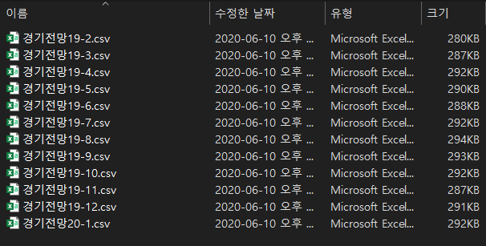
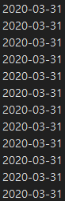
3. CAR: Process_3.3. CAR: Project Design
Data Gathering : Ministry of SMEs and Startups (Korea, Republic of)
1
(https://www.mss.go.kr/site/smba/foffice/ex/statDB/temaList.do)
For one month,
Various features assessment data
of the SMEs are provided
one file. (normalized structured data)
We collected 12 Datafiles: from January 2019 to February 2020.

Slide 12
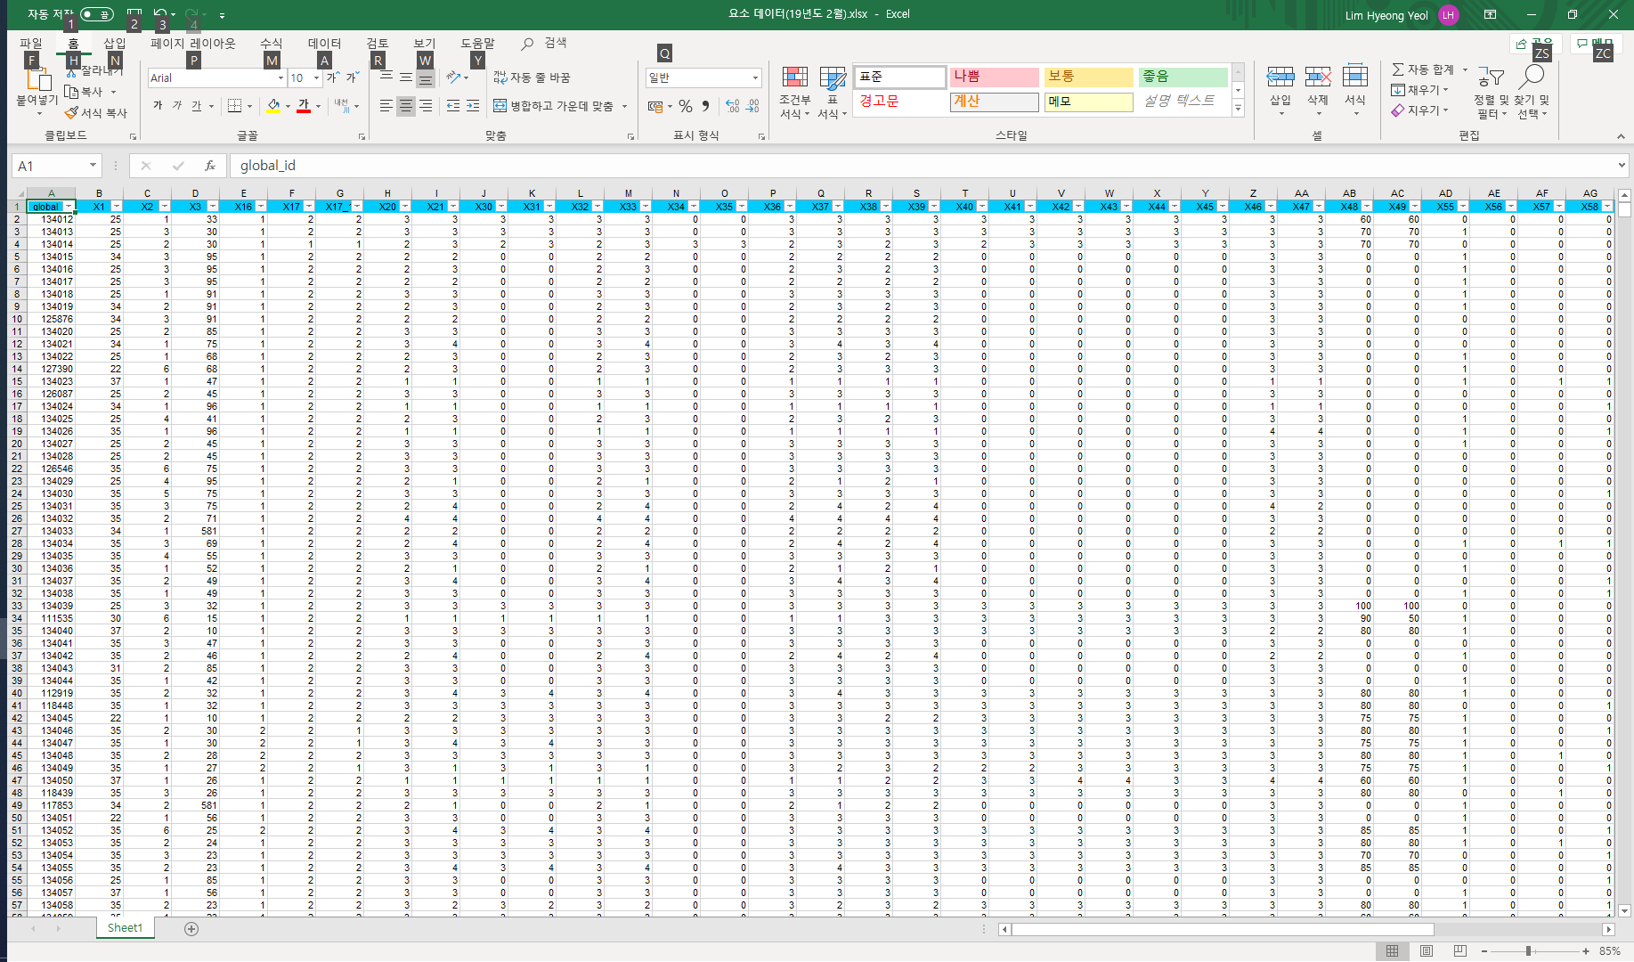
3. CAR: Process_3.3. CAR: Project Design
Data Analysis : Open datafile sample (use Excel..)
2
The process of viewing the data structure directly
& selecting the features that we need.
The Data properties are as follows:
Global id: SMEs code
X1: region code
X16~: Features of SMEs
(Evaluated by the Ministry of SMEs)
There are So many SMEs
& Features in this file.
We chose features
only what to Analyze.

Slide 13
3. CAR: Process_3.3. CAR: Project Design
Data Analysis : Select Analysis Target Data
2
There are So many SMEs(2,364) & Features(45) in these files.
From this data, the SMEs to be analyzed were chosen
to those based in GWANGJU/JEONNAM,
and only the top 10 features were selected.
The following are the results of the selection.
SMEs
To Analyze
197
GWANGJU : 127
JEONNAM : 70
2,364
Limitation SMEs Data
(based in Gwangju/Jeonnam)
Features
To Analyze
Limitation features Data
In order of magnitude:
the impact on liquidity crisis.
45
10

Slide 14
3. CAR: Process_3.3. CAR: Project Design
Data Analysis : Selected features
2
We calculated the Weight of each feature
Through Consultation with an Economic Expert.
 | Column name | Weight
Fund assessment performance | X38 | 25.0%
Domestic demand outlook | X33 | 15.0%
Delay in returning sales amount | X57 | 11.0%
Financial difficulties | X58 | 9.0%
Operating profit performance | X36 | 8.5%
Excessive competition among SMEs | X59 | 7.5%
Business outlook | X21 | 7.0%
Difficulties in securing manpower | X60 | 6.5%
Labor cost increase status | X61 | 6.0%
Export outlook | X35 | 3.5%
TOTAL | - | 100%
These three features
are the most important.
The sum of the weights is 51%
These seven features
are less important.
The sum of the weights is 49%

Slide 15
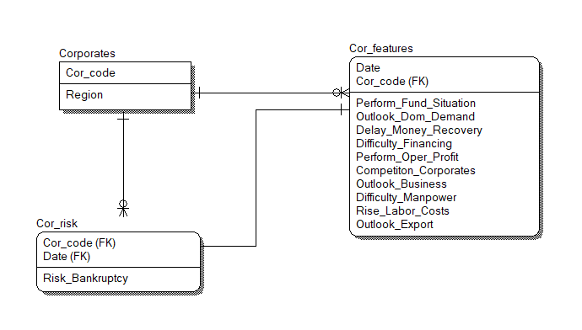
3. CAR: Process_3.3. CAR: Project Design
DB Model Design
2
We designs a table structure
that includes 10 selected features as attributes.

Slide 16
3. CAR: Process_3.3. CAR: Project Implementation
The project Implemention is divided into three detail steps:
Data
Processing
These include the three processes:
1. Limitation the Number of SMEs which we want analysis
2. Missing values resolution
3. Features extraction / Calculation of bankruptcy rate
1
Store
Data
2
Storing processed data
in a table form in the database(DB)
Web Site
Build
3
Build a Web Site using a Web Framework
Visualize and Expose data stored in DB to Web Site.

Slide 17
3. CAR: Process_3.3. CAR: Project Implementation
Data Processing
1
1. Limitation the Number of SMEs which we want analysis :
We selected SMEs data which based in Gwangju/Jeonnam
This is the result of data selection
Before
(Total)
After
197
GWANGJU : 127
JEONNAM : 70
2,364
Limitation SMEs Data
(based in Gwangju/Jeonnam)

Slide 18
3. CAR: Process_3.3. CAR: Project Implementation
Data Processing
1
2. Missing values resolution :
Unfortunately, Our data had missing values.
We discussed this, and drew out two solutions :
- Resolving missing values with Pre&Post data
(Not recommended because of accuracy)
- Resolving missing values using the branch average
where missing values exists
We solved missing values in a second way.

Slide 19
3. CAR: Process_3.3. CAR: Project Implementation
Data Processing
1
3. Features extraction / Calculation of bankruptcy rate
Column(Description) | Weight
Fund assessment performance | 25.0%
Domestic demand outlook | 15.0%
Delay in returning sales amount | 11.0%
Financial difficulties | 9.0%
Operating profit performance | 8.5%
Excessive competition among SMEs | 7.5%
Business outlook | 7.0%
Difficulties in securing manpower | 6.5%
Labor cost increase status | 6.0%
Export outlook | 3.5%
TOTAL | 100%
We extracted the 10 chosen features.
And calculated the bankruptcy rate
using the weight of each feature
and added it to the Dataframe.
The bankruptcy rate
was calculated dividing
by the All 12 after multiplied
by the weighted values and features.
The bankruptcy rate
was displayed up to
the second decimal place.

Slide 20
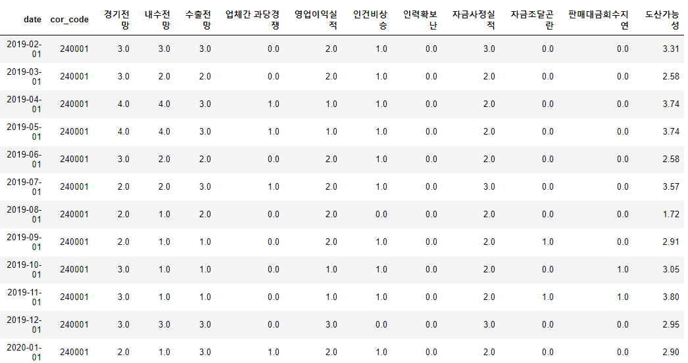
3. CAR: Process_3.3. CAR: Project Implementation
Store Data
2
This is the Dataframe after data processing is completed
We extracted only the columns we needed here
and imported them to Database in table form.
Date
SMEs code
Features(10)
Bankruptcy rate

Slide 21
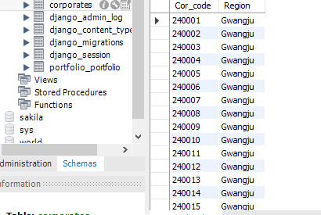
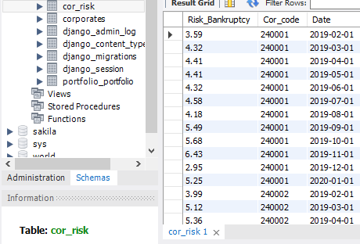
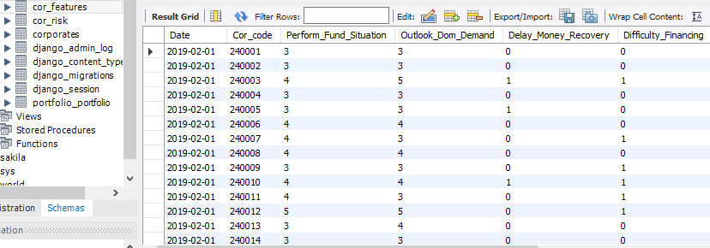
3. CAR: Process_3.3. CAR: Project Implementation
Store Data : result
2
This is the result after import data to DB
Corporates
Cor_risk
Cor_features

Slide 22
3. CAR: Process_3.3. CAR: Project Implementation
Web Site Build
3
This is the conceptual diagram that we want to implement
(In the form of a Web Site)
Bankruptcy Ranking
(in Gwangju)
Main Page
Bankruptcy Ranking
(About all SMEs)
Bankruptcy Ranking
(in Jeonnam)
Bankruptcy Ranking
(Search)
We proceeded with Data Visualization by utilizing data within DB
Including a brief description, provide this material as a Web Site.

Slide 23
4. CAR: Result
The results that we implemented are as follows.
Main Page
Default Page
(The main page of the web Site that we have implemented.)
Bankruptcy Ranking
(About all SMEs)
Form of a Dashboard,
Displayed Top 10 SMEs with high bankruptcy rate
Visualize analysis data for the SMEs
- Located in Gwangju / Jeonnam
- That you searched
Display with description.
Bankruptcy Ranking
(in Gwangju/Jeonnam)
Bankruptcy Ranking
(search)

Slide 24
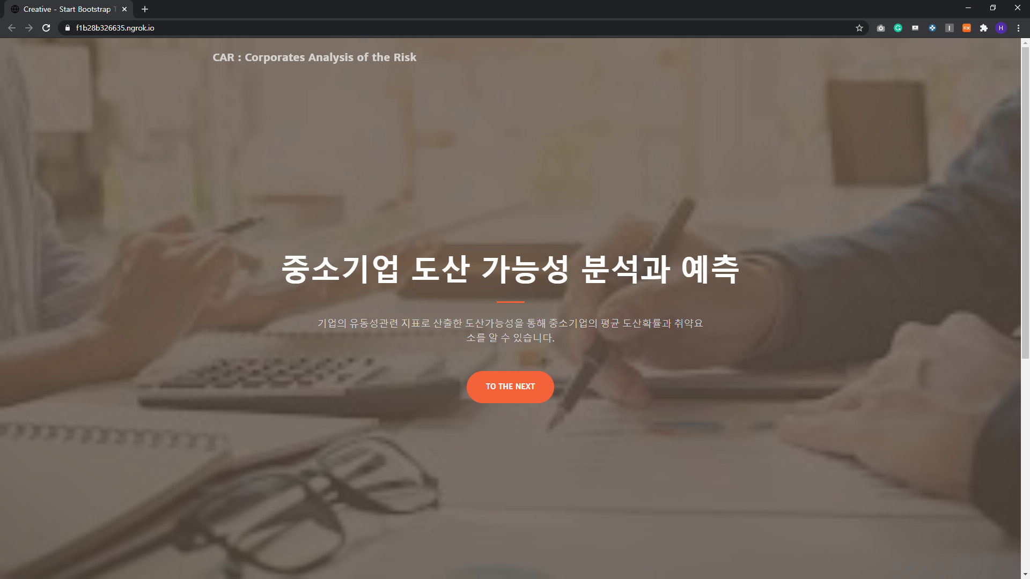
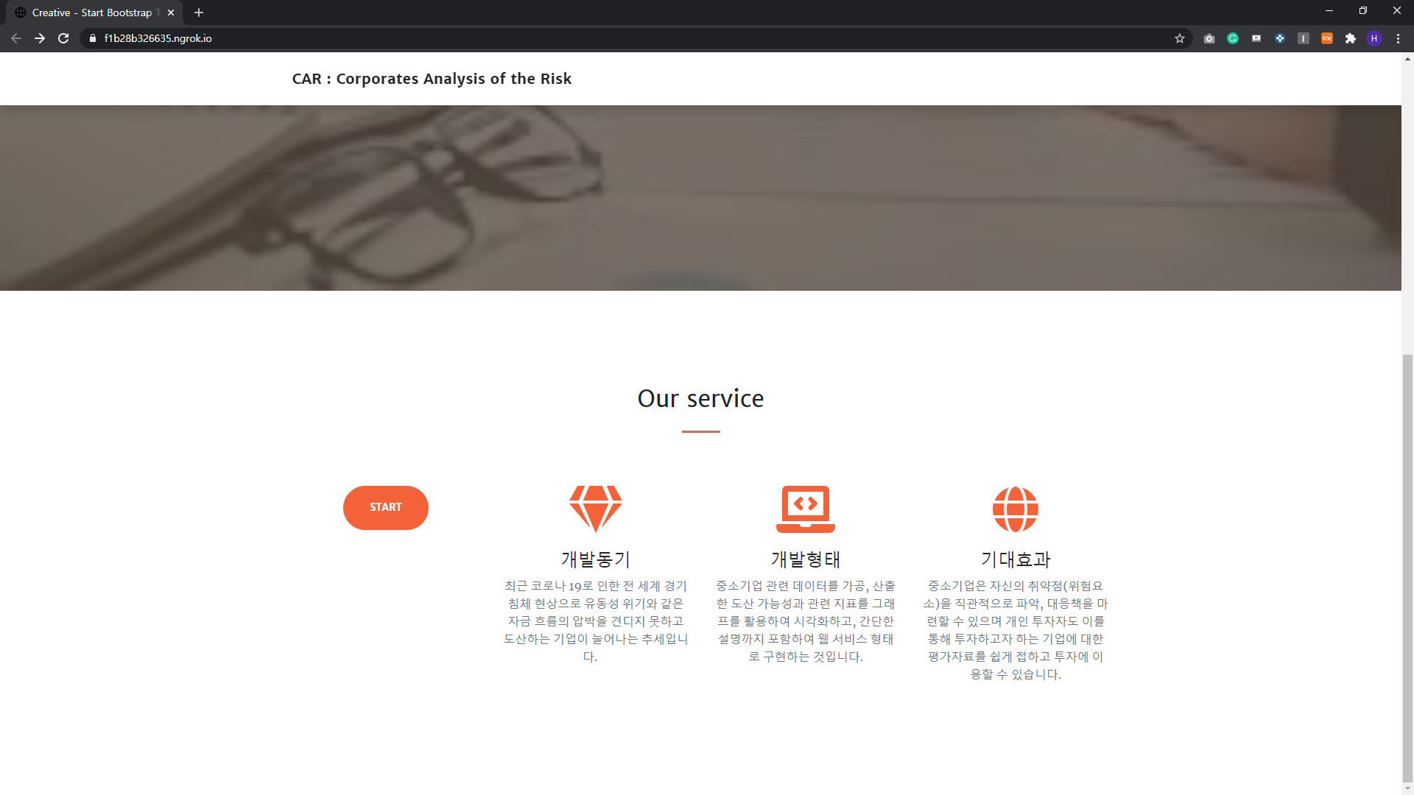
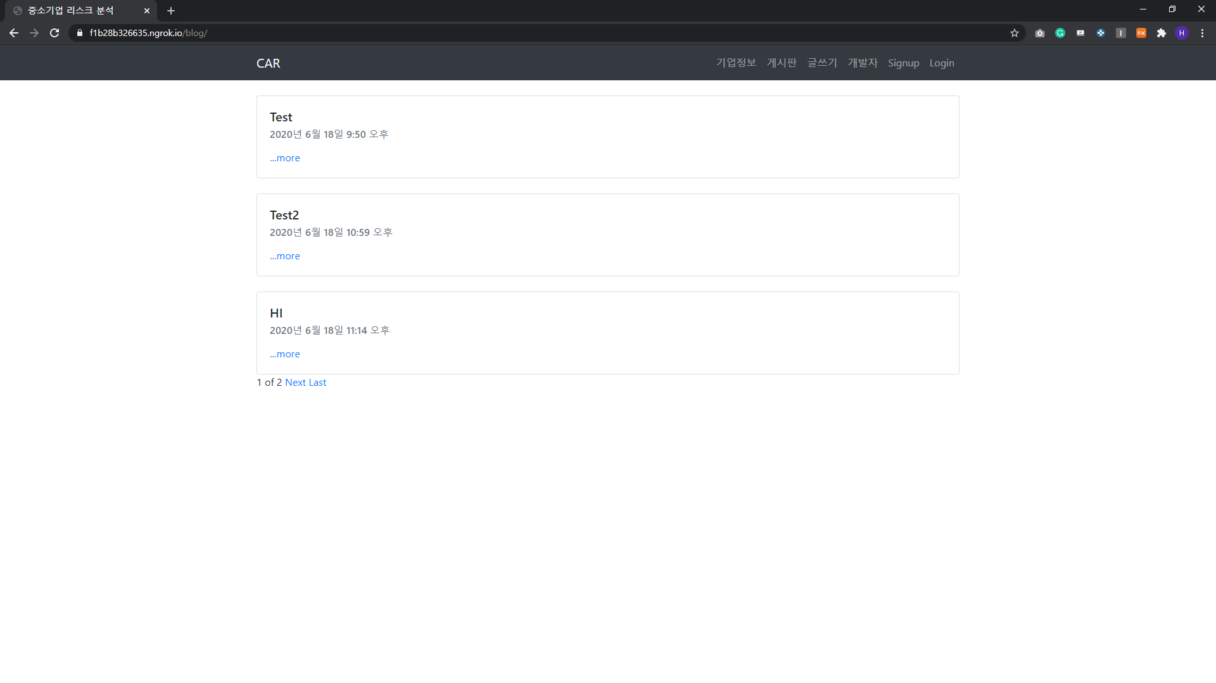
4. CAR: Result
Main Page
If you click 'Corporate Information’,
you can move to a branched page.
- Bankruptcy rate(about region/SMEs)

Slide 25
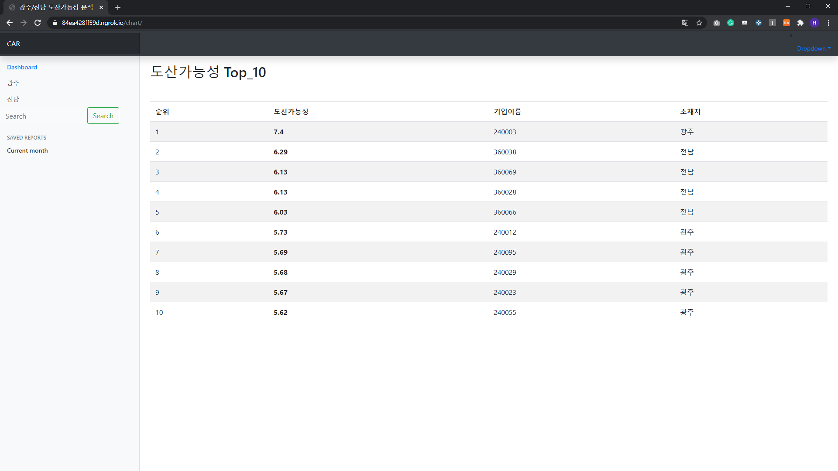
4. CAR: Result
Bankruptcy Ranking (All SMEs)
In the form of a Dashboard, the Top 10 SMEs with high Bankruptcy rates are marked.

Slide 26
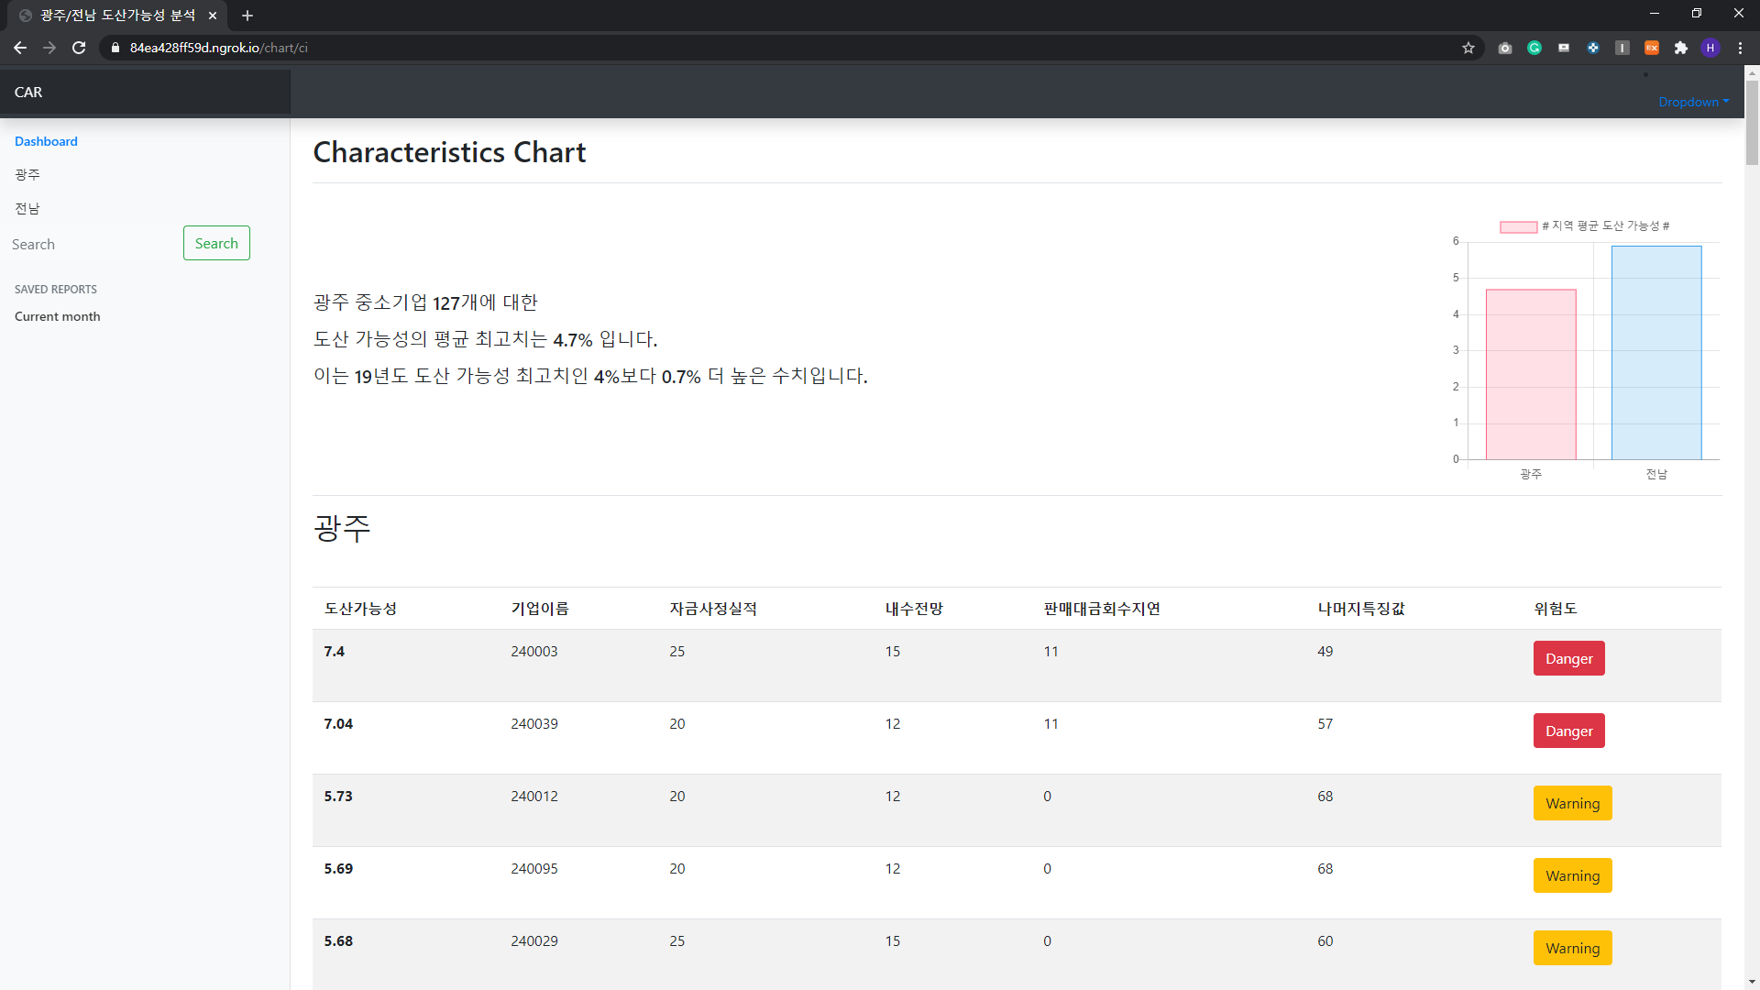
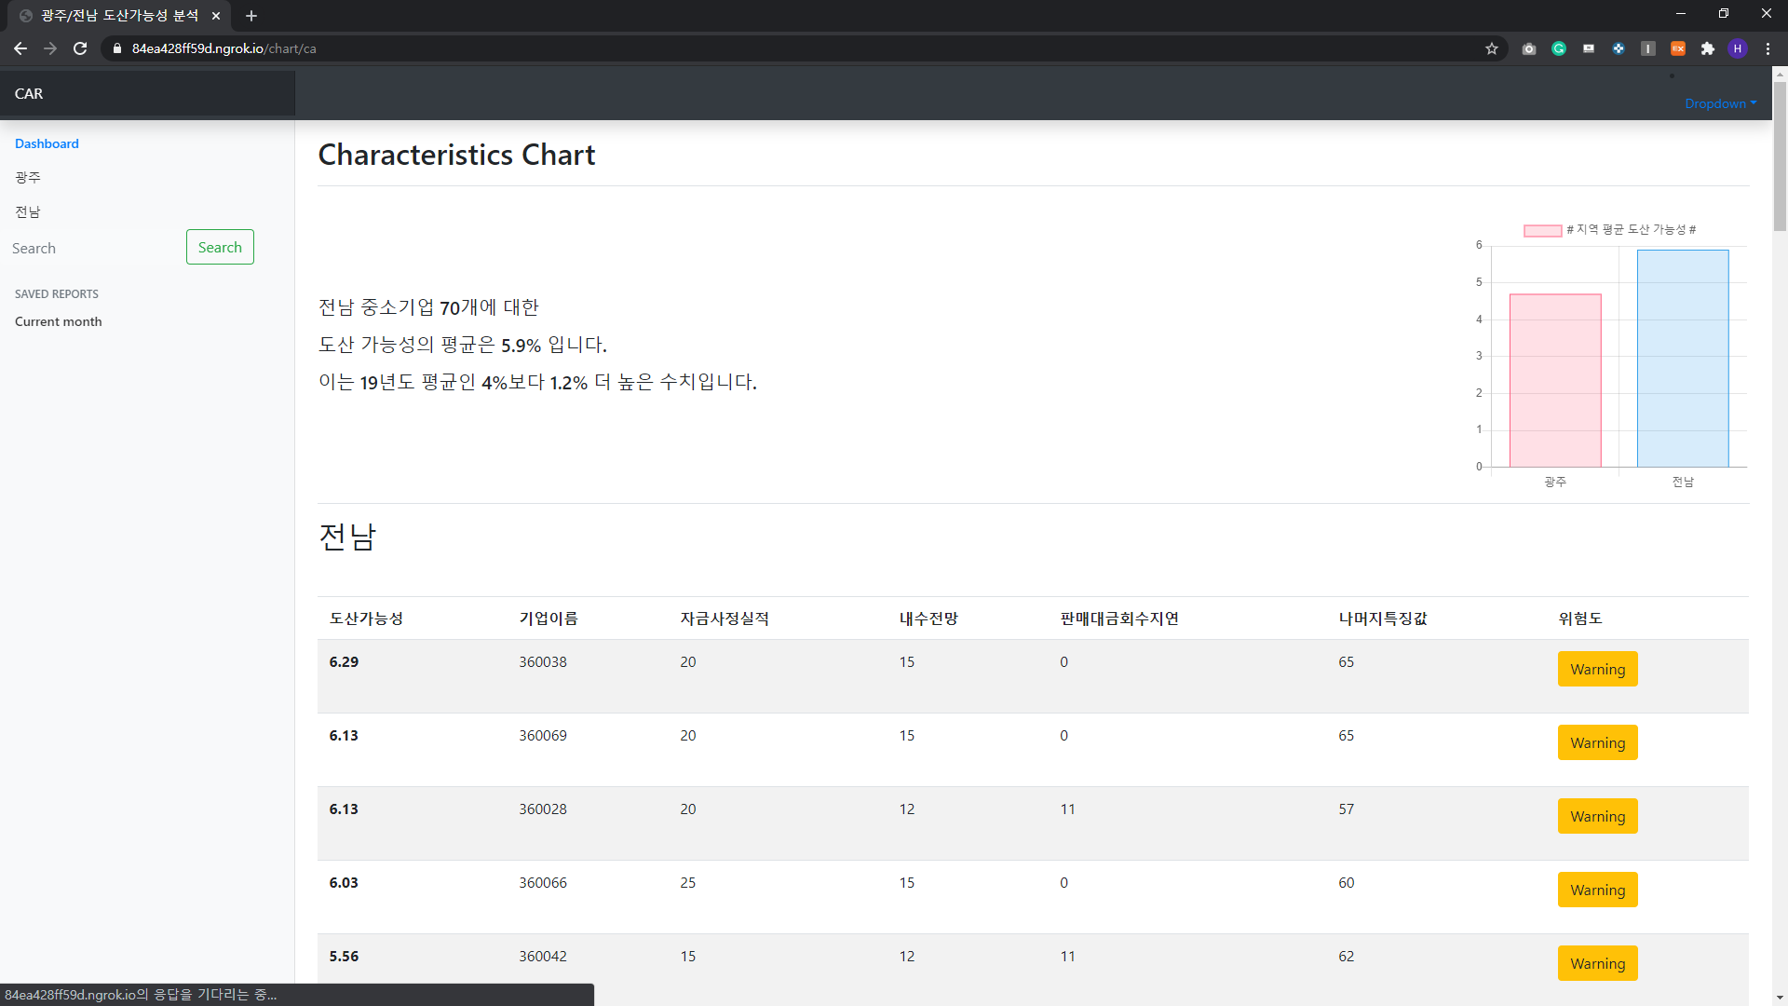
4. CAR: Result
Bankruptcy Ranking (Gwangju / Jeonnam)
Visualized the average
Bankruptcy rate of the region
and showed a description.
In descending order by Bankruptcy rate and showed each feature percentage.
Both pages provide the same functionality.

Slide 27
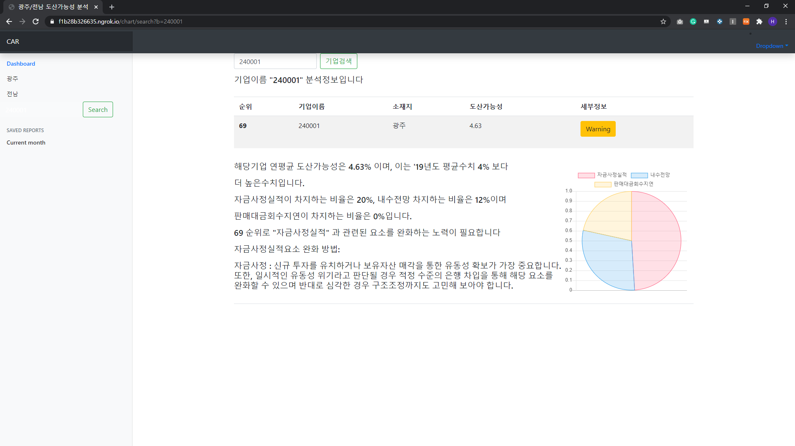
4. CAR: Result
Bankruptcy Ranking (Search)
Visualized and displayed the analysis results
for the SMEs that searched.
- Bankruptcy rate
- Percentage of each feature (graph)
- Brief Description

Slide 28
4. CAR: Result
Project(Web Site) Address:
https://
Traffic is limited now,
So only 4-5 people
can connect at the same time

Slide 29
5. CAR: References
파이썬으로 데이터 주무르기 민형기, 비제이퍼블릭
파이썬 라이브러리를 활용한 데이터 분석 웨스 맥키니, 한빛미디어
Django로 배우는 쉽고 빠른 웹 개발 : 파이썬 웹 프로그래밍 김석훈, 한빛미디어
(https://m.blog.naver.com/PostView.nhn?blogId=wiseyoun07&logNo=221135110180&proxyReferer=https:%2F%2Fwww.google.com%2F)
(https://antilibrary.org/700)
(https://velog.io/@devmin/Django-MySQL-Connect)
(https://juneyr.dev/2018-02-19/make-bulk-update-from-csv-Django)
(https://moonlighting.tistory.com/140)
(https://lsjsj92.tistory.com/480)

Slide 30
5. CAR: References
(https://news.mt.co.kr/mtview.php?no=2017012415025747064)
(https://dowtech.tistory.com/3)
(https://yongbeomkim.github.io/django/django-d3/)
(https://coding-factory.tistory.com/180)
(https://unikys.tistory.com/369)
(https://steemit.com/kr/@tanky/django-or-feat-highcharts)

Slide 31
Q & A
Thanks for watching!
Github : https://github.com/cutiecrab/CAR

